Slide 1
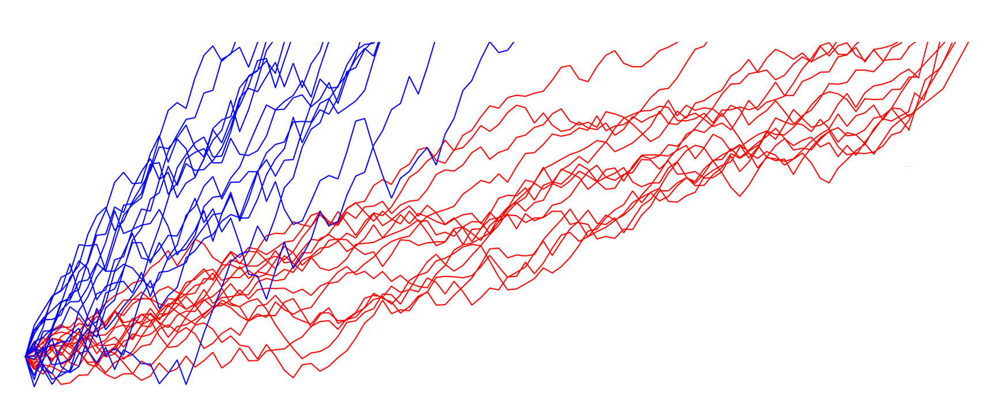
“Fast”
Drift rate (v)
“Slow”
Drift rate (v)
a
Correct
(Upper Boundary)
Non-
Decision
Time (t)
Boundary
separation (a)
Bias (z)
Incorrect
(Lower Boundary)
0
Reaction Time

Slide 2
Correct Error Difference
µV
0-80ms

Slide 3
Session 1
Correct Error Difference
µV
Session 2
µV
Session 3
0-80ms
µV
0-80ms

Slide 4
Session 2
Correct Error Difference
µV
0-80ms

Slide 5
Session 3
Correct Error Difference
µV
0-80ms

